Slide 1

MediSearch — Intelligent Medical Information Retrieval System
V.G Shanmukhasai – 2520030341
M. Vignesh - 2520030065
Dept. of Computer Science & Engineering

Slide 2

Abstract
MediSearch is an intelligent medical information retrieval system that enables users to search diseases, medicines, symptoms, treatments, and evidence-based healthcare content with high speed and precision. Unlike conventional keyword-only search, MediSearch integrates advanced data structures and algorithmic techniques — including tries and string-matching (KMP, Rabin–Karp, Aho–Corasick), dynamic programming for edit-distance, graph-based similarity and ranking, approximation strategies for scalable queries, and randomized hashing for fast deduplication — to deliver typo-tolerant, context-aware, and efficiently ranked results over large medical corpora. The project implements these concepts end-to-end: client-side smart auto-completion (Trie + prefix queries), backend fuzzy matching (Edit Distance + KMP/Rabin–Karp hybrids), and graph-based recommendation/ranking for related conditions and drug interactions. MediSearch is designed for practical use by clinicians and researchers, demonstrating how Advanced Algorithms syllabus topics map directly to real-world healthcare search challenges while preserving scalability, responsiveness, and relevance.

Slide 3
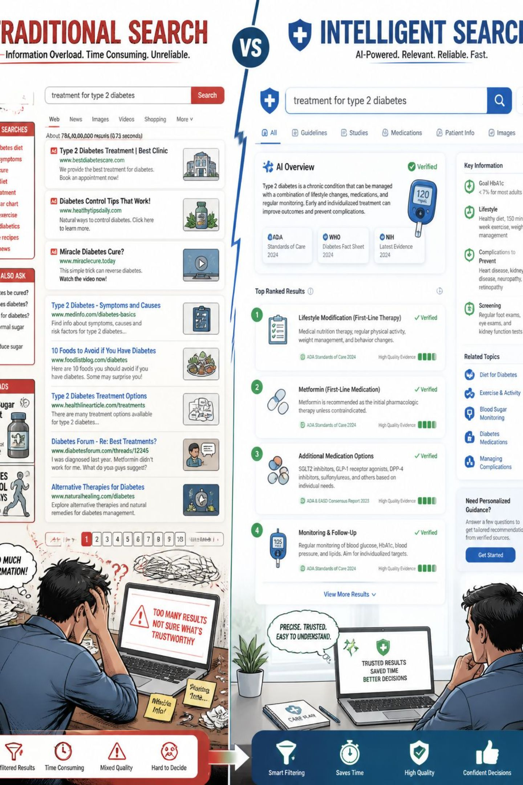
Problem Statement
Current medical search systems face multiple issues when applied to large healthcare datasets:
Slow query response and indexing on large corpora
Irrelevant, keyword-driven results lacking semantic ranking
Poor handling of misspellings and typos common in clinical notes
Inefficient retrieval and high latency for complex queries
Limited intelligent recommendations for related diagnoses or drug interactions
Healthcare professionals require a fast, accurate, and scalable platform that supports typo-tolerance, contextual ranking, and intelligent recommendations for clinical decision support.

Slide 4
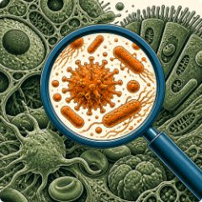
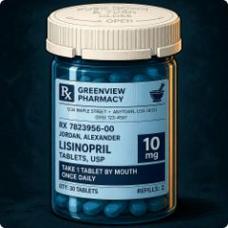








Proposed Functionalities
Disease Search
Medicine Search
Symptom-Based Search
Treatment Search
Structured matching of disease names, ICD codes, and synonyms (Aho–Corasick, Trie).
Drug lookup, dosage hints, and interactions using graph traversal.
Evidence-ranked treatments and protocol retrieval backed by ranking algorithms.
Reverse lookup from symptom sets to likely conditions (approximate matching).
Smart Auto-Completion
Spell Correction
Intelligent Ranking
Drug Interaction Search
Edit-distance and probabilistic correction using dynamic programming and hashing.
Prefix search with Trie for instant, ranked suggestions and typo tolerance.
Graph-based scoring and approximation algorithms for relevance and speed.
Graph traversal for interaction detection and safety alerts.
Medical Article Search
Scalable DB & UI
Fast retrieval, responsive UI, and a user-friendly glassmorphism interface.
Full-text matching with KMP/Rabin–Karp hybrids and Aho–Corasick for multi-pattern queries.
Workflow diagram: User → Query Parsing → Algorithmic Matching (Trie / KMP / Edit Distance) → Graph Ranking → Ranked Results.

Slide 5
Tools & Technologies
Frontend
Backend
Database
Algorithms
HTML • CSS • JavaScript • React.js
Node.js • Express.js
MongoDB
Trie, KMP, Rabin–Karp, Aho–Corasick
Glassmorphism UI, responsive design
REST APIs, indexing services
Document store, inverted indexes
Edit Distance (DP), Graph Algorithms, Approximation, Randomized Hashing
Dev Tools
Libraries
Testing
Deployment
VS Code • GitHub
React, Express, Mongoose
Postman, Jest
Docker, Heroku / Cloud
Technology logos: React, Node.js, MongoDB, GitHub (displayed as inline icons).

Slide 6
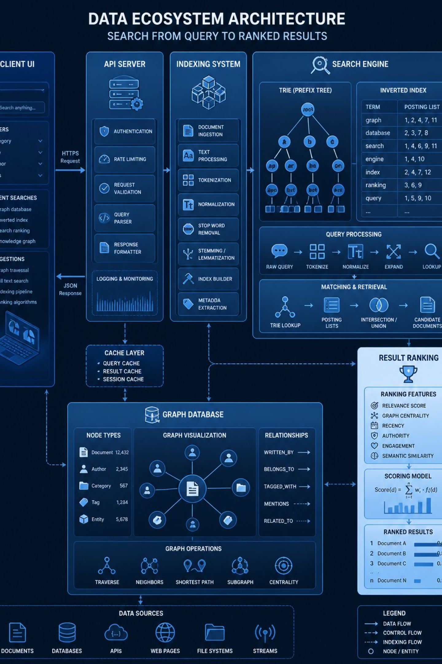
System Architecture & Algorithms Mapping
Core components:
How syllabus concepts appear in the implementation:
Client: React UI with Trie-based autocomplete
Search API: Tokenization, KMP/Rabin–Karp for exact & substring matching
Fuzzy Engine: Edit-distance DP for typo correction and candidate pruning
Ranking Layer: Graph algorithms for related-condition ranking and PageRank-style scoring
Scalability: Approximation algorithms and randomized hashing for fast deduplication and sampling
Text Search Concepts
Inverted indexes, multi-pattern matching, token normalization.
String Matching
KMP/Rabin–Karp for fast scans; Aho–Corasick for multi-pattern extraction.
Graph Algorithms
Graph traversal and centrality for recommendations and interaction maps.

Slide 7
Expected Outcome & Evaluation
Impact
Performance Goals
Accuracy Goals
Low-latency queries, scalable indexing, efficient memory usage.
High precision & recall on medical queries; improved ranking relevance.
Fast, relevant retrieval; typo tolerance; clinically useful recommendations; demonstrable reduction in query latency versus baseline keyword search.
Educational Goals
Concrete mapping of Advanced Algorithms concepts to system modules for course evaluation.
Visual flow: Fast Search → Relevant Results → Improved Decision Making → Better Healthcare Support.

Slide 8

Thank You
2520030341 – V.G SHANMUKHASAI
2520030065 – M. VIGNESH

